Slide 1

Environmental Management
By: Alaa Saber
Demonstrator of Community Environmental and Occupational Medicine Department

Slide 2
When Did Environmental Management Begin?
1972 – Major Turning Point
The first global milestone was the United Nations Conference on the Human Environment (1972), organized by the United Nations in Stockholm.
This conference marked the beginning of international cooperation in environmental protection and laid the foundation for modern environmental management.

Slide 3

Introduction
Environmental Management, as addressed by the World Health Organization (WHO), is a core component of Environmental Health. It focuses on identifying, assessing, controlling, and preventing environmental factors that can adversely affect human health, with an emphasis on primary prevention rather than treatment.

Slide 4

Why did WHO use the term Environmental Management?
The World Health Organization (WHO) adopted the term Environmental Management because environmental problems are:
  Complex and long-term
  Cannot be solved by a single action
  Require planning, organization, implementation, monitoring, and evaluation
  The term management reflects a systematic and continuous approach rather than simple observation or treatment.

Slide 5
Core Components of Environmental Management (WHO Framework)
Risk Identification and Assessment
Water, Sanitation and Hygiene (WASH)
Air Quality Management
Waste Management
Chemical Safety
Vector Control through Environmental Management
Climate Change and Environmental Health
Restoration of Ecosystems and Biodiversity

Slide 6
Risk Identification and Assessment
WHO emphasizes identifying environmental hazards that pose health risks, including:
Physical hazards (noise, radiation, heat)
Chemical hazards (air pollutants, pesticides, heavy metals)
Biological hazards (pathogens, vectors)
Social and built environment risks
Tools used include:
Environmental risk assessment
Health impact assessment (HIA)
Environmental monitoring and surveillance

Slide 7
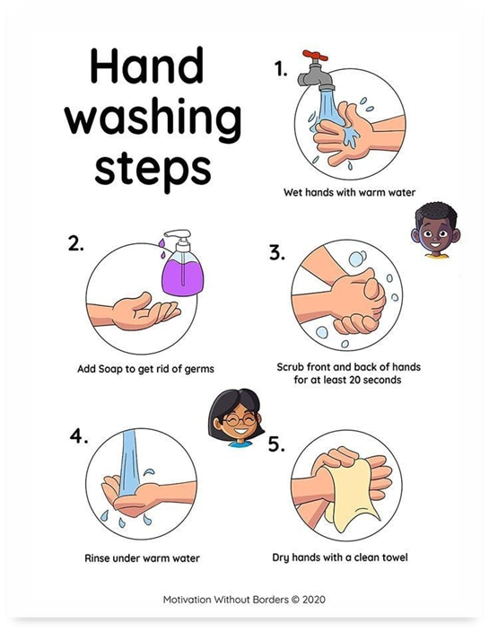
Water, Sanitation and Hygiene (WASH)
A major WHO priority area:
Ensuring safe and sufficient drinking water
Proper sanitation systems to prevent fecal–oral diseases
Promotion of hygiene practices (e.g., handwashing)
WHO links poor WASH conditions directly to:
Diarrheal diseases
Cholera
Typhoid
Parasitic infections

Slide 8
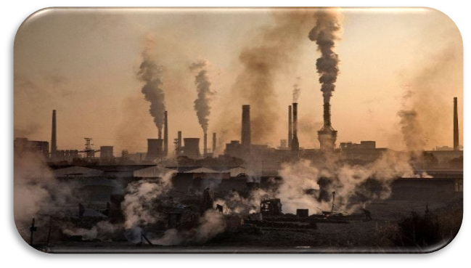
Air Quality Management
  WHO addresses both:
  - Outdoor air pollution (PM2.5, PM10, NO₂, SO₂)
  - Indoor air pollution (solid fuel combustion, tobacco smoke)
  Environmental management strategies include:
  - Setting air quality guidelines
  - Reducing emissions at source
  - Promoting clean household energy

Slide 9

Waste Management
WHO focuses on safe management of:
Municipal solid waste
Hazardous waste
Healthcare waste (sharps, infectious waste, pharmaceuticals)
Goals:
Prevent disease transmission
Reduce environmental contamination
Protect waste workers and communities

Slide 10

Chemical Safety
WHO’s environmental management includes:
Regulation of chemicals and pesticides
Prevention of acute and chronic poisoning
Management of chemical spills and emergencies
This includes:
Risk communication
Safe handling and disposal
International chemical conventions collaboration

Slide 11


Vector Control through Environmental Management
WHO promotes environmental methods as sustainable vector control strategies:
- Elimination of stagnant water
- Proper waste disposal
-Housing improvements
This reduces diseases such as:
Malaria
Dengue
Zika
Leishmaniasis

Slide 12
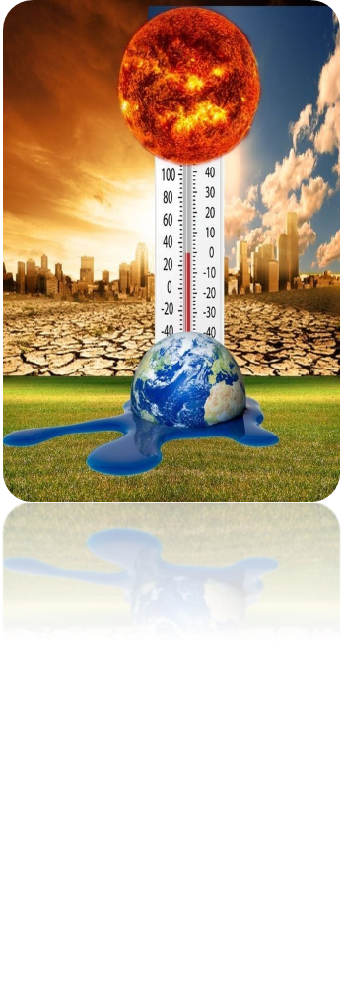

Climate Change and Environmental Health
WHO integrates environmental management into climate action by:
Reducing health risks from heatwaves, floods, and droughts
Strengthening climate-resilient health systems
Promoting sustainable urban and transport planning

Slide 13

Restoration of Ecosystems and Biodiversity:
Initiate reforestation projects .
Identify important natural habitats and rehabilitation.
Engage local communities in the planting and protection of natural species.

Slide 14

WHO Principles Guiding Environmental Management

Slide 15
WHO Principles Guiding Environmental Management
Prevention-first approach
Equity and protection of vulnerable populations
Evidence-based decision-making
Intersectoral collaboration
Sustainable development alignment

Slide 16
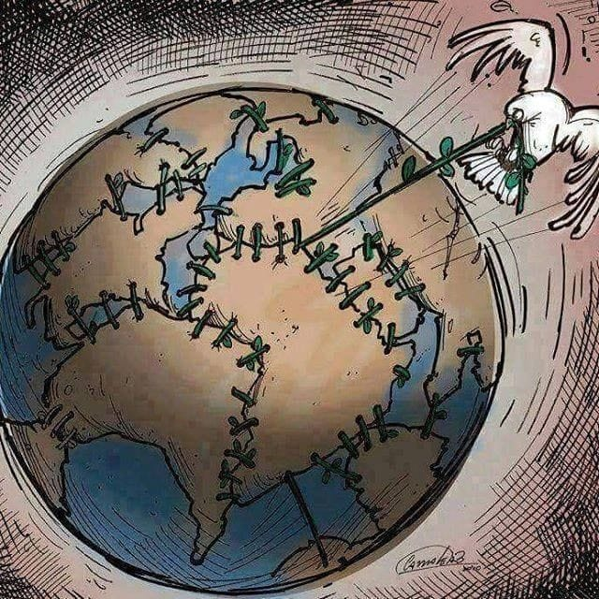
Importance of Environmental Management (WHO Perspective)
WHO estimates that:
A significant proportion of global disease burden is environment-related.
Effective environmental management can prevent millions of deaths annually

Slide 17
conclusion
Environmental management, according to the World Health Organization, is a systematic, prevention-focused approach to controlling environmental factors that affect human health. By addressing water, sanitation, air quality, waste, chemical safety, vector control, climate, and healthy settings, it aims to reduce disease, protect vulnerable populations, and promote sustainable development.

Slide 18
Reference
World Health Organization & UNICEF. (2025). Water, sanitation, hygiene and environmental cleaning in health care facilities.
https://iris.who.int/handle/10665/381684
World Health Organization. (2022). Compendium of WHO and other UN guidance on health and environment (WHO/HEP/ECH/EHD/22.01)
https://iris.who.int/handle/10665/352844
World Health Organization. Environmental health in emergencies and disasters: https://www.who.int/publications-detail-redirect/9241545410
World Health Organization. Environmental health
https://www.who.int/health-topics/environmental-health

Slide 19

Thank you

