Slide 1
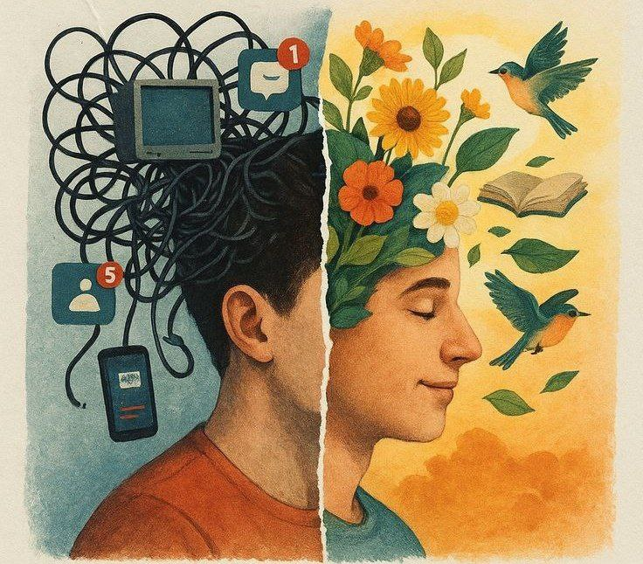
Digital Detox
(Back to Nature)
By: Esraa Abdel Daim
Demonstrator of Community Environmental and Occupational Medicine Department

Slide 2

In today’s world, we are constantly connected.
We check our phones hundreds of times a day.
The 21st century is characterized by digital saturation, with average screen times exceeding 6–8 hours/day globally.
But this digital overload has serious effects on our mental and physical well-being.

Slide 3

Impacts of
D I G I T A L

Slide 4
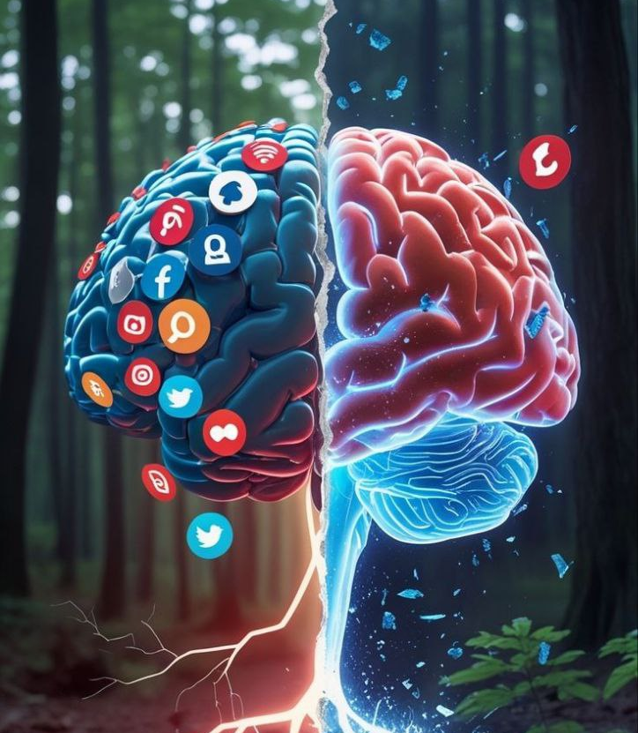
🧠Mental Health Impacts:
Cognitive Fatigue.
Anxiety and Stress.
Sleep Disorders.
Attention Deficits.
Reduced working memory capacity.
Hyperactivity in the default mode network (DMN) → reduced task engagement.
Poor self-esteem
Social comparison via a platform leads to chronic dissatisfaction.
"Fear of Missing Out" (FOMO) effect.

Slide 5
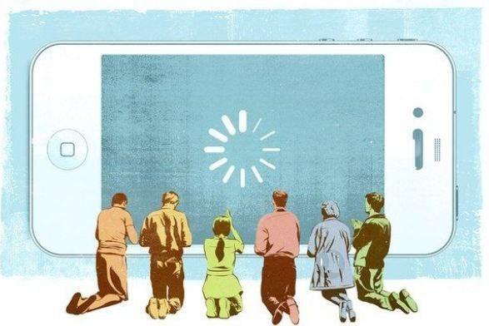
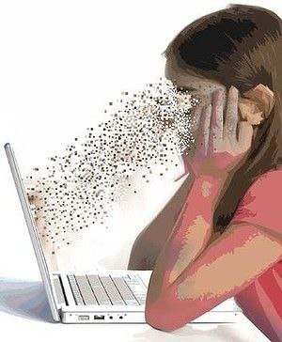
🧭 Lifestyle and Social Impacts:
Social Disconnection.
Reduced Productivity.
Tech Dependency.
Digital Addiction Patterns.
💪 Physical Health Impacts:
Visual Strain (Computer Vision Syndrome).
Musculoskeletal Issues.
Sedentary Behavior.

Slide 6
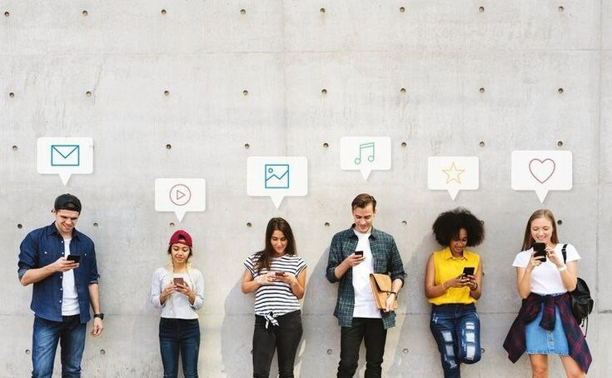
Adolescents and young adults are at greater risk due to their developing brains.

Slide 7
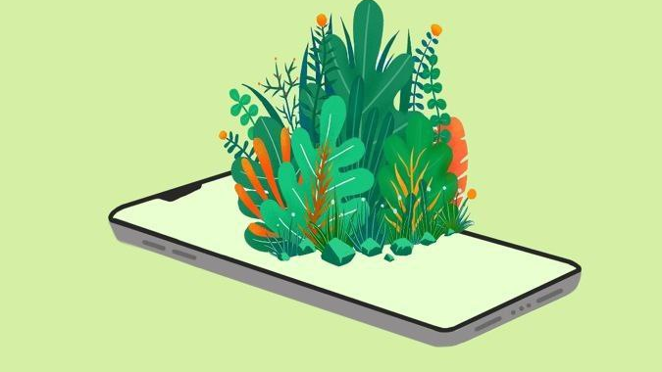
Let’s explore how “Digital Detox” and Back to Nature can help us restore balance.

Slide 8

Digital Detox
A period of time during which a person refrains from using digital devices like smartphones, computers, and social media platforms to focus on real-life interactions.
Examples:
Turning off your phone for a weekend.
Avoiding social media for a week.
Spending time outdoors without any gadgets.

Slide 9
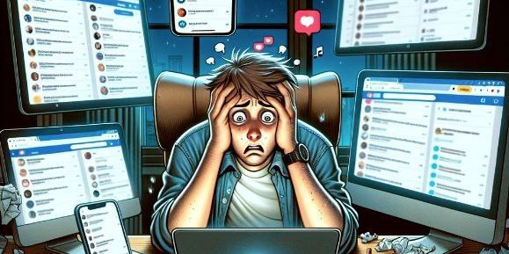

Signs You Need a Digital Detox

Slide 10

Digital Detox in Nature
“Green time” instead of “screen time”
Notes:
The perfect compo

Slide 11

Back to Nature
"The practice of spending time in natural environments to promote physical, mental, and emotional well-being."
Examples:
Forest walks
Beach days without phones
Camping or hiking trips
Stargazing
Nature retreats or eco-lodges

Slide 12
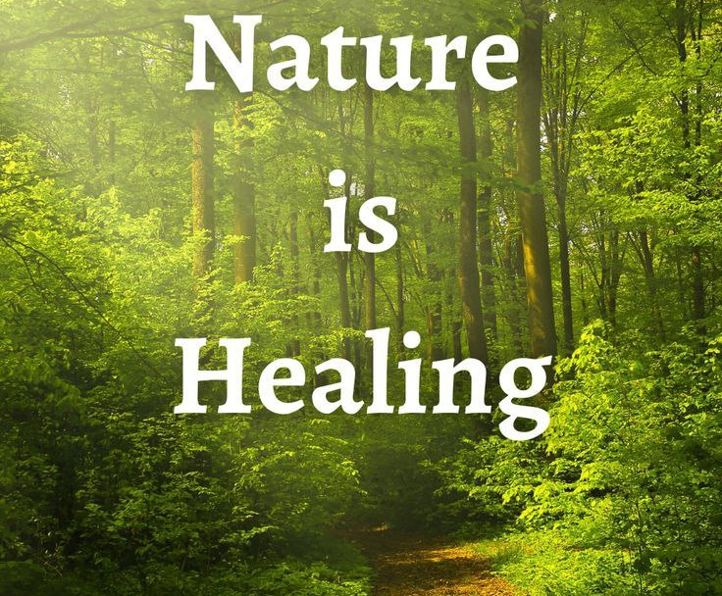
20 minutes a day helps!
Notes:
Nature heals — even 20 minutes a day helps!

Slide 13
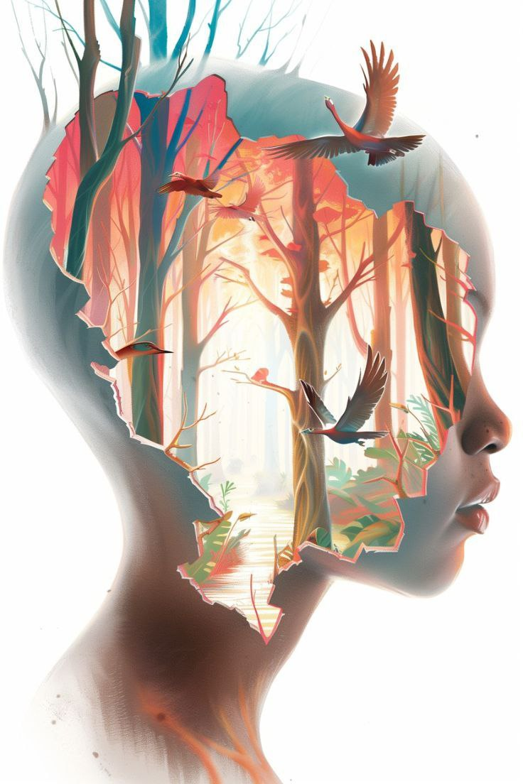
The Role of Nature:
🧠Cognitive Restoration.
(Attention Restoration Theory )
Psychological and Emotional Regulation.
🧭Encouraging Mindfulness and Presence.
👥 Supporting Real-World Social Interaction.
🚶 Behavioral Shift Toward Simplicity and Balance.

Slide 14
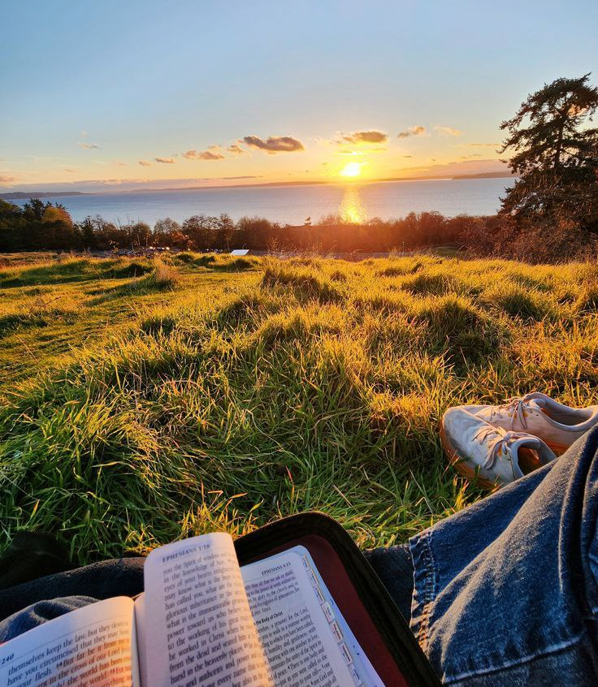
💪 Physical Benefits of back to Nature:
Instead of just focusing on posture health:
Improved circadian rhythms.
More physical movement (walking, hiking).
Exposure to sunlight → Vitamin D production.
Enhanced lung function from cleaner air.

Slide 15
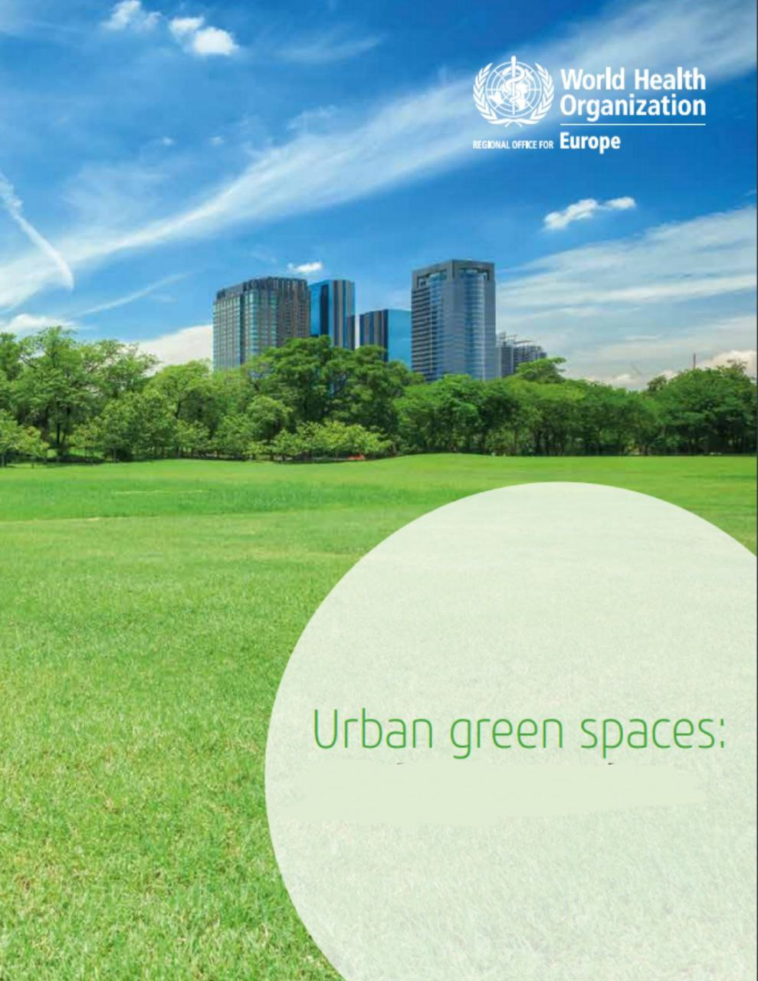
WHO Urban Green Space Guidelines:
WHO recognizes urban green spaces as essential to public health.
Aim:
to support cities in planning and maintaining green spaces that promote physical, mental, and social well-being

Slide 16
🌿 Key Recommendations:
1. 🔲 Accessibility: green space within 300 meters (about a 5-minute walk) from their home.
2. 🏞️ Quality & Safety:
Green spaces should be clean, safe, and welcoming for all ages and abilities.
3. 🌳 Health Equity:
Urban green space planning must consider vulnerable populations (children, elderly, low-income groups) to reduce health disparities.
4. 🌍 Environmental Impact: Green spaces support urban biodiversity, reduce air pollution, mitigate heat island effects, and improve water management.
5. 🤝 Social & Community Benefits: Green spaces foster social interaction, promote active lifestyles, and reduce stress and mental fatigue.

Slide 17
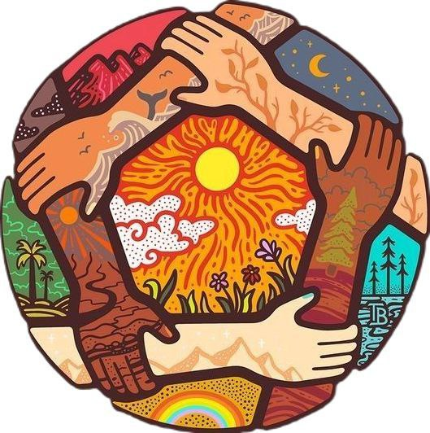
The Role of Culture in Digital Habits:
Cultural differences in screen usage and nature exposure.
Digital overload is higher in urbanized, high-income
regions.
Some traditional cultures naturally practice “digital detox” through religious or nature-based rituals.

Slide 18
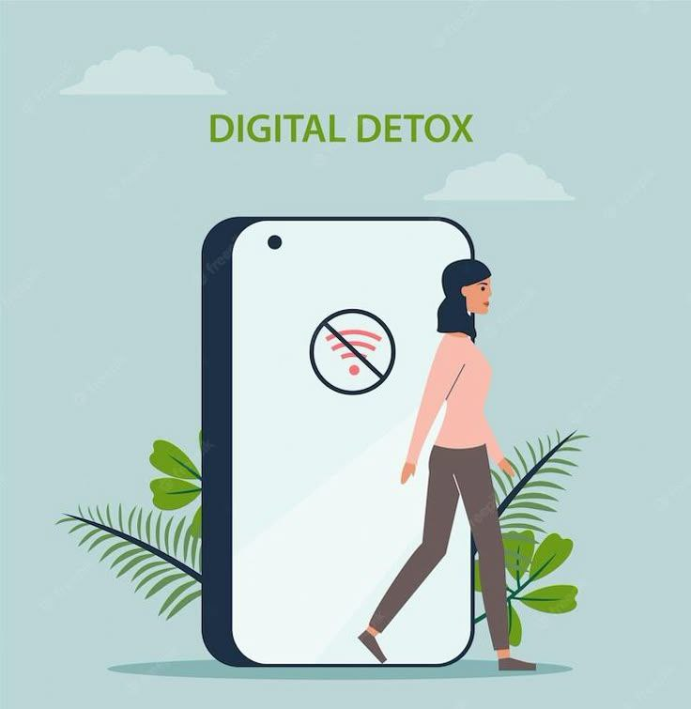
How Can We Practice

Slide 19

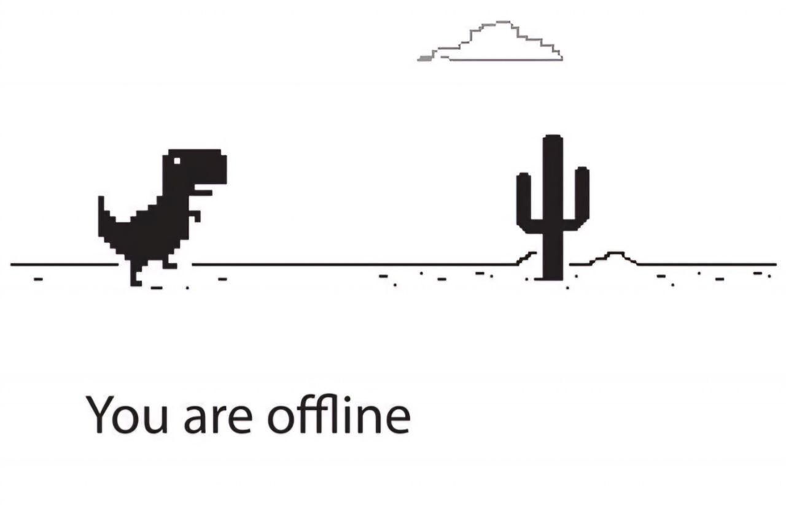
How Can We Practice Digital Detox?
Set a screen-time limit each day.
Have “no phone” hours (e.g., before bed).
Turn off notification.
Spend at least 30 minutes in nature daily.

Slide 20

Nature Is Everywhere:
You don’t need a forest — a balcony, garden, or nearby park is enough.
Even looking at plants or nature photos can help.

Slide 21

Barriers to Digital Detox and Nature Access:
Urbanization and lack of green spaces.
Work and study tech-dependency.
Socioeconomic inequality in nature access.
Psychological resistance: "Digital fear of disconnection.

Slide 22

Healthy tech use includes pauses, not total withdrawal.

Slide 23

Bridging the Gap – Digital and Nature Balance:
Not rejecting technology but Promoting digital minimalism + nature connection.

Slide 24
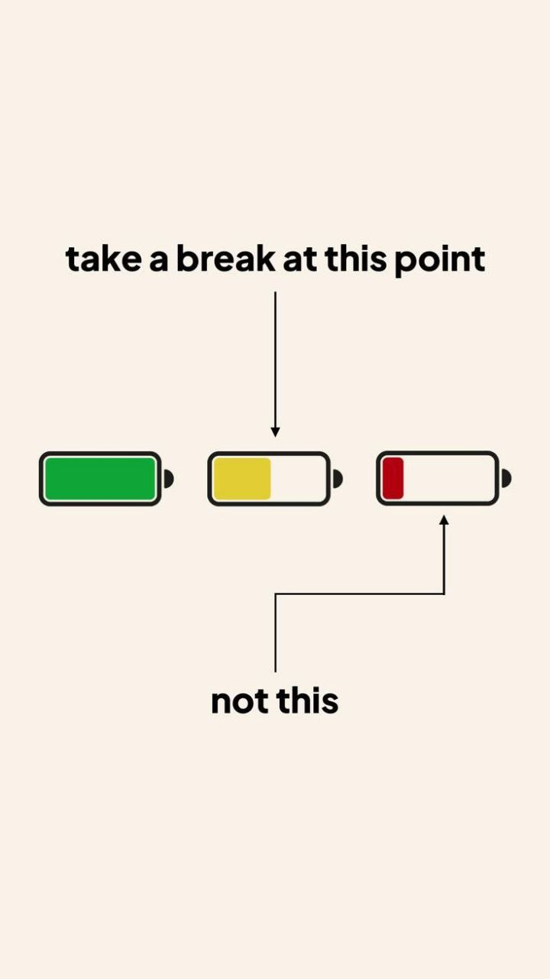
Digital Minimalism:
Using technology with intention.
Decluttering digital life.
Being selective about screen time.

Slide 25

Notes:
"We don’t have to reject technology, but we should learn when to use it — and when to take a break and enjoy the peace of nature."

Slide 26
📚 References:
Twenge, J. M. (2020). The associations between screen time and mental health. Journal of Adolescent Health.
National Institute for Health and Care Excellence (NICE). (2022). Physical activity and the outdoors.
Kaplan, R., & Kaplan, S. (1989). The Experience of Nature: A Psychological Perspective.
Berman, M.G., Jonides, J., & Kaplan, S. (2008). The cognitive benefits of interacting with nature. Psychological Science.
Bratman, G.N. et al. (2015). Nature experience reduces rumination and subgenual prefrontal cortex activation. PNAS.
World Health Organization. (2017). Urban green spaces: A brief for action. Available at: https://www.who.int/publications/i/item/9789289052918
Setia, S. et al. (2025). Digital Detox Strategies and Mental Health: A Comprehensive Scoping Review of Why, Where, and How. PubMed.

Slide 27


