Slide 1
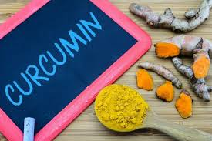

Slide 2
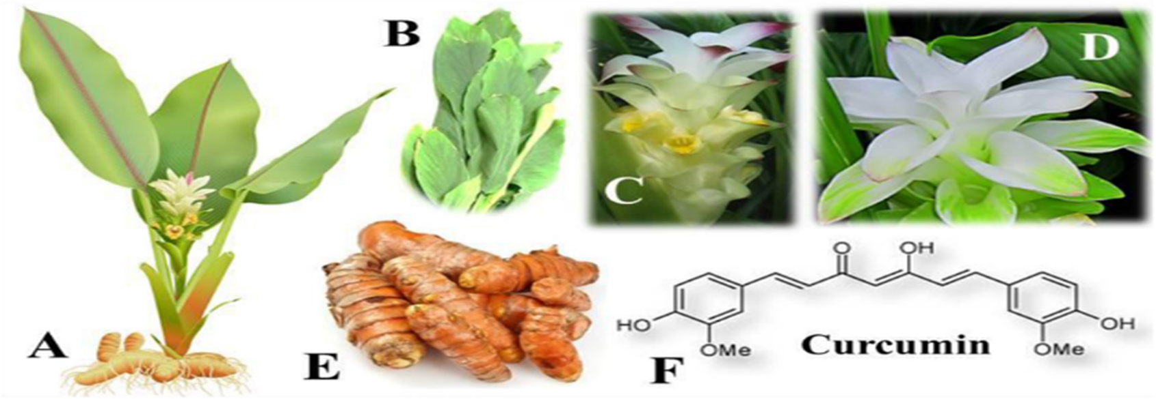
Curcumin is a secondary metabolite derived from Curcuma longa. It is widely utilized as a natural coloring agent and food additive, and has been reported to have various therapeutic properties.

Slide 3
Pharmacokinetic studies indicate that curcumin generally has low biovailability following oral administration. Despite this limitation, pharmacologically active concentrations of curcumin have been detected in colorectal tissue in patients taking it orally. Similar therapeutic concentrations might also be achievable in tissues such as the skin and oral mucosa, which are directly exposed to curcumin when applied locally.
To address the challenge of low bioavailability, various strategies have been explored. One notable approach involves the use of adjuvants like piperine, which can enhance the absorption and systemic availability of curcumin.

Slide 4
Despite its low bioavailability, the therapeutic efficacy of curcumin against various human diseases including cancer, cardiovascular diseases, arthritis, neurological disorders, and Crohn’s disease has been well documented. This efficacy is largely attributed to its antioxidative, anti-inflammatory, and anticancer properties.
Enhancing the bioavailability of curcumin in the near future is expected to elevate this promising natural compound to the forefront of therapeutic agents for the treatment of human diseases.

Slide 5
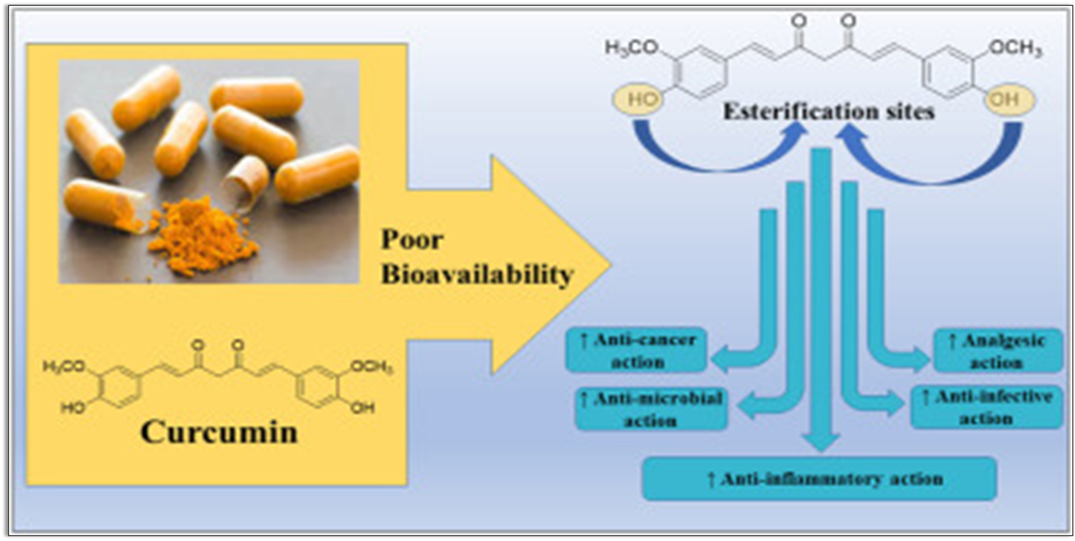

Slide 6
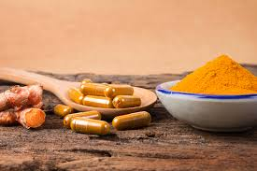
Curcumin function
curcumin

Slide 7
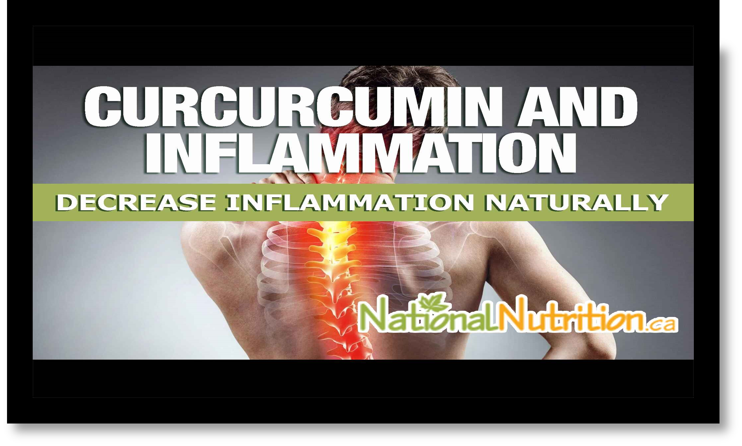

Slide 8

Anti-inflammatory Effect of Curcumin
curcumin is widely recognized for its potent anti-inflammatory effect. Mechanisms of Action :curcumin has been shown to inhibit key enzymes involved in the inflammatory response, including cyclooxygenase-2 (COX-2), lipoxygenase (LOX), and inducible nitric oxide synthase (iNOS). Through these mechanism, curcumin may help reduce inflammation and provide therapeutic benefits in a range of inflammatory conditions.
Dose:
Curcumin extract (with piperine): 500 mg, 1–2 times per day with food.

Slide 9
Anticancer Potential of Curcumin
Extensive research over the past 50 years has shown that curcumin has promising anticancer properties, both in cancer prevention and treatment.
Mechanisms of Action : Curcumin exerts its anticancer effects through multiple biological pathways:
Inhibition of tumor cell proliferation across a wide variety of cancers.
Down-regulation of transcription factors involved in cancer progression.
Suppression of pro-inflammatory enzymes:Cyclooxygenase-2 (COX-2) Lipoxygenase (LOX)

Slide 10
Reduction in expression of chemokines, which play a role in tumor growth and metastasis. Inhibition of cell surface adhesion molecules, disrupting cancer cell adhesion and migration. Down-regulation of growth factor receptors, which are often overexpressed in cancer cells. For Cancer Prevention Clinical trials have used high doses of curcumin, typically in the range of:1,000–8,000 mg per day However, such high doses should be taken only under medical supervision, due to potential interactions with cancer Other medications

Slide 11
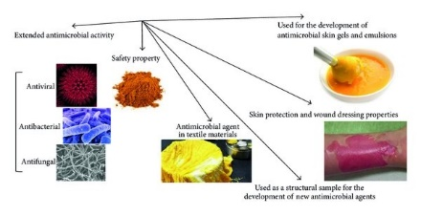
Antimicrobial Potential of Curcumin
Curcumin has broad-spectrum antimicrobial activity, making it a promising natural compound in combating various infections including those caused by antibiotic-resistant strains.

Slide 12
Antibacterial Activity:
Curcumin is effective against a wide range of bacteria through several mechanisms: - Inhibition of Bacterial Virulence Factors: By disrupting the expression and function of virulence factors such as:Toxins ,Enzymes (e.g., proteases, lipases)
-Prevention of Bacterial Adhesion to Host Receptors: By blocking bacterial adhesins or altering host receptor sites,
-curcumin reduces the ability of bacteria to:Adhere to epithelial or mucosal surfaces
Dosage in Research Studies:
Most clinical and preclinical studies utilize curcumin in dosages ranging from 500 mg to 2,000 mg per day.

Slide 13
Antiviral Potential of Curcumin
Curcumin has shown antiviral activity against a variety of viruses, including:Influenza virus ,Hepatitis C virus (HCV) ,Human immunodeficiency virus (HIV) ,Herpes simplex virus (HSV).
Mechanisms of Action:Direct inhibition of viral replication: Curcumin can interfere with the virus's ability to replicate by targeting viral enzymes and genetic material.
Suggested Dosage:
500 mg to 2,000 mg per day, taken in divided doses.

Slide 14
Improved Brain Function
Research suggests that curcumin may enhance brain function by increasing levels of brain-derived neurotrophic factor (BDNF)—a protein essential for brain health.
Low BDNF levels are associated with neurodegenerative diseases such as Alzheimer’s disease.
Clinical studies commonly use 400–500 mg of curcumin extract daily when exploring its effects on conditions like Alzheimer’s.

Slide 15
Heart Health Benefits of Curcumin
Improves Endothelial Function:
Curcumin supports the endothelium—the inner lining of blood vessels—helping
regulate:Blood pressure ,Blood clotting ,Vascular relaxation and constriction
Anti-inflammatory and Antioxidant Effects:
These properties reduce chronic inflammation, a key contributor to heart disease.
Cholesterol Management:
Curcumin may help:Lower LDL (bad cholesterol)
Increase HDL (good cholesterol)
Reduce triglyceride levels
Recommended Dosage for Heart Health:
500 mg to 1,000 mg of curcumin extract daily

Slide 16
Joint Health & Curcumin
Anti-inflammatory Benefits: Curcumin, the active compound in turmeric, has strong anti-inflammatory properties that may help manage symptoms of joint conditions such as osteoarthritis and rheumatoid arthritis.
Potential Benefits:Reduced pain
Less stiffness
Improved mobility
Recommended Dosage for Joint Pain/Inflammation:
500 mg to 1,000 mg daily

Slide 17
Digestive Health Benefits of Curcumin
Promotes bile production, aiding fat digestion.
Reduces symptoms like indigestion and bloating.
May assist in managing inflammatory bowel diseases (IBD) such as Crohn’s disease and ulcerative colitis.
Recommended Dosage:
Typical dose for digestive issues or IBD: 500 mg twice daily.
Some studies have used doses up to 1,000 mg per day.

Slide 18


Slide 19
Curcumin Side Effects
curcumin is generally safe when consumed in moderate amounts (such as in food or supplements). However, excessive intake or sensitivity can cause some side effects:
Gastrointestinal Issues:
High doses may lead to stomach upset, nausea, or diarrhea.
Interference with Medications:
Curcumin can interact with medications for high blood pressure, and chemotherapy, potentially affecting how well these medicines work.
Allergic Reactions:
Though rare, some people might experience rashes, swelling, or difficulty breathing.

Slide 20
Gallbladder Issues: Curcumin might worsen symptoms in people who have gallstones or bile duct obstructions. This is because curcumin can increase bile production, potentially causing more problems. Kidney and Liver Issues: High doses of curcumin might negatively affect kidney or liver function, especially in people with existing kidney or liver conditions.

