Slide 1
Back to nature
Moringa Oleifera
Dr. Amal Kamel
Demonstrator of Clinical Pharmacology

Slide 2
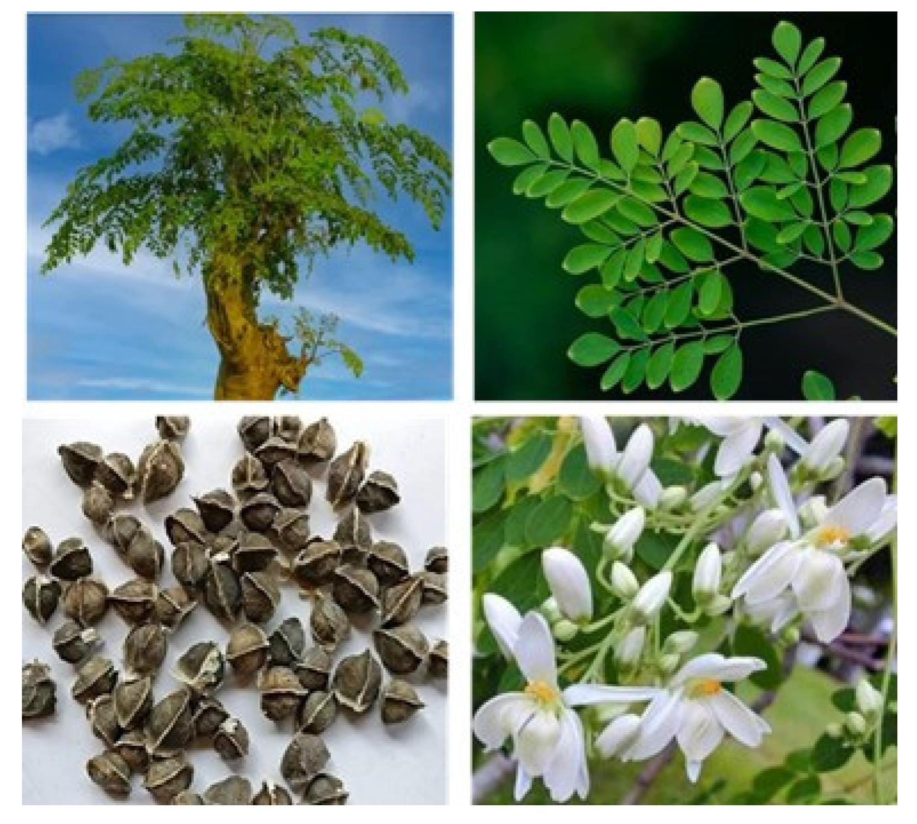
Moringa oleifera
also known as the “tree of life” or “miracle tree,” is classified as an important herbal plant due to its immense medicinal and non-medicinal benefits.

Slide 3
Morphology of moringa oleifera tree:
Moringa oleifera is a small, fast-growing evergreen tree that usually grows with height about 9 meters, with a soft and white wood and corky and gummy bark. Roots have the taste of horseradish. Leaves are about 30-75 cm long main axis, with not toothed margins, and is rounded or blunt-pointed at the apex and short-pointed at the base, the twigs are finely hairy and green, flowers are white, and pods (fruits) are pendulous, ribbed. Each pod usually contains up to 26 seeds which are dark green during their development and take up to 3months to mature after flowering.

Slide 4
Neutrional value of Moringa oleifera:
Vital minerals are present in the Moringa oleifera including iron, potassium, calcium, copper, zinc, magnesium, manganese , vitamins A and D, essential amino acids, as well as such known antioxidants such as β-carotene, vitamin C, and flavonoids. MO is rich in nutrition due to the presence of a many essential phytochemicals present in its leaves, pods and seeds. In fact, Moringa is said to provide 7 times more vitamin C than oranges, 10 times more vitamin A than carrots, 17 times more calcium than milk, 9 times more protein than yoghurt, 15 times more potassium than bananas and 25 times more iron than spinach. The seeds of MO have a very high amount of fat with a high energy value. So can be used to combat malnutrition and to assure nutritional security. The seed oil of Moringa is a rich source of oleic acid, tocopherols and sterols.

Slide 5
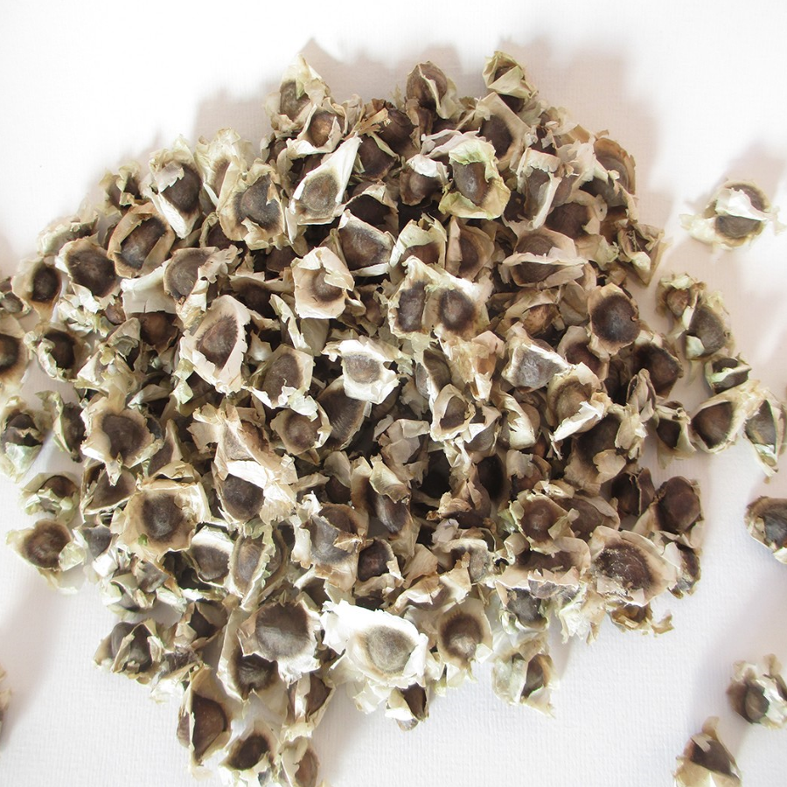
Moringa oleifera seeds extract value:
Moringa oleifera seeds contain high amount of antioxidant compounds such as phenolics and flavonoids are important indicators of antioxidant capacity of M. oleifera seeds, polyphenol content in MO seeds are well known to have antioxidative power and effective scavenging of free radicals .Those phyto-constituents serve in plant defense mechanisms to counteract Reactive Oxygen Species in order to survive, prevent molecular damage in humans and other organisms.MO seed extract exerts bactericidal activity against Gram-positive and Gram-negative bacteria.. Antimicrobial activity is also related to the presence of a short cationic protein. This protein, known as the MO cationic protein, that cause bacterial cell damage through rapid flocculation and the fusion of inner and outer membranes of the cell.

Slide 6
The seeds are roasted and mixed with coconut oil and used for their antibiotic and anti-inflammatory properties to treat arthritis, rheumatism, gout, cramp, sexually transmitted diseases and boils. Roasted seeds and oil can encourage urination and can be used as a relaxant for epilepsy.
Seed extract of Moringa has a suppressive effect on macrophages and neutrophils and inhibits phagocytosis, so it can be considered as an immune-modulator and/or immune-suppressive.
Seed extract suppresses prostaglandin biosynthesis through an inhibitory effect on COX-I and COX-II enzymes, and suppresses leukotriene biosynthesis; also it was effective in blocking production of several cytokines including TNF-α, IL-4, and IL-6. It is probable that it has additional mechanisms such as mast cells stabilization.
Recent studies observe a cytotoxic effect of MO oil in several cancer cell lines due to Many bioactive compounds isolated from MO seeds have been found to be potential antitumor action.

Slide 7
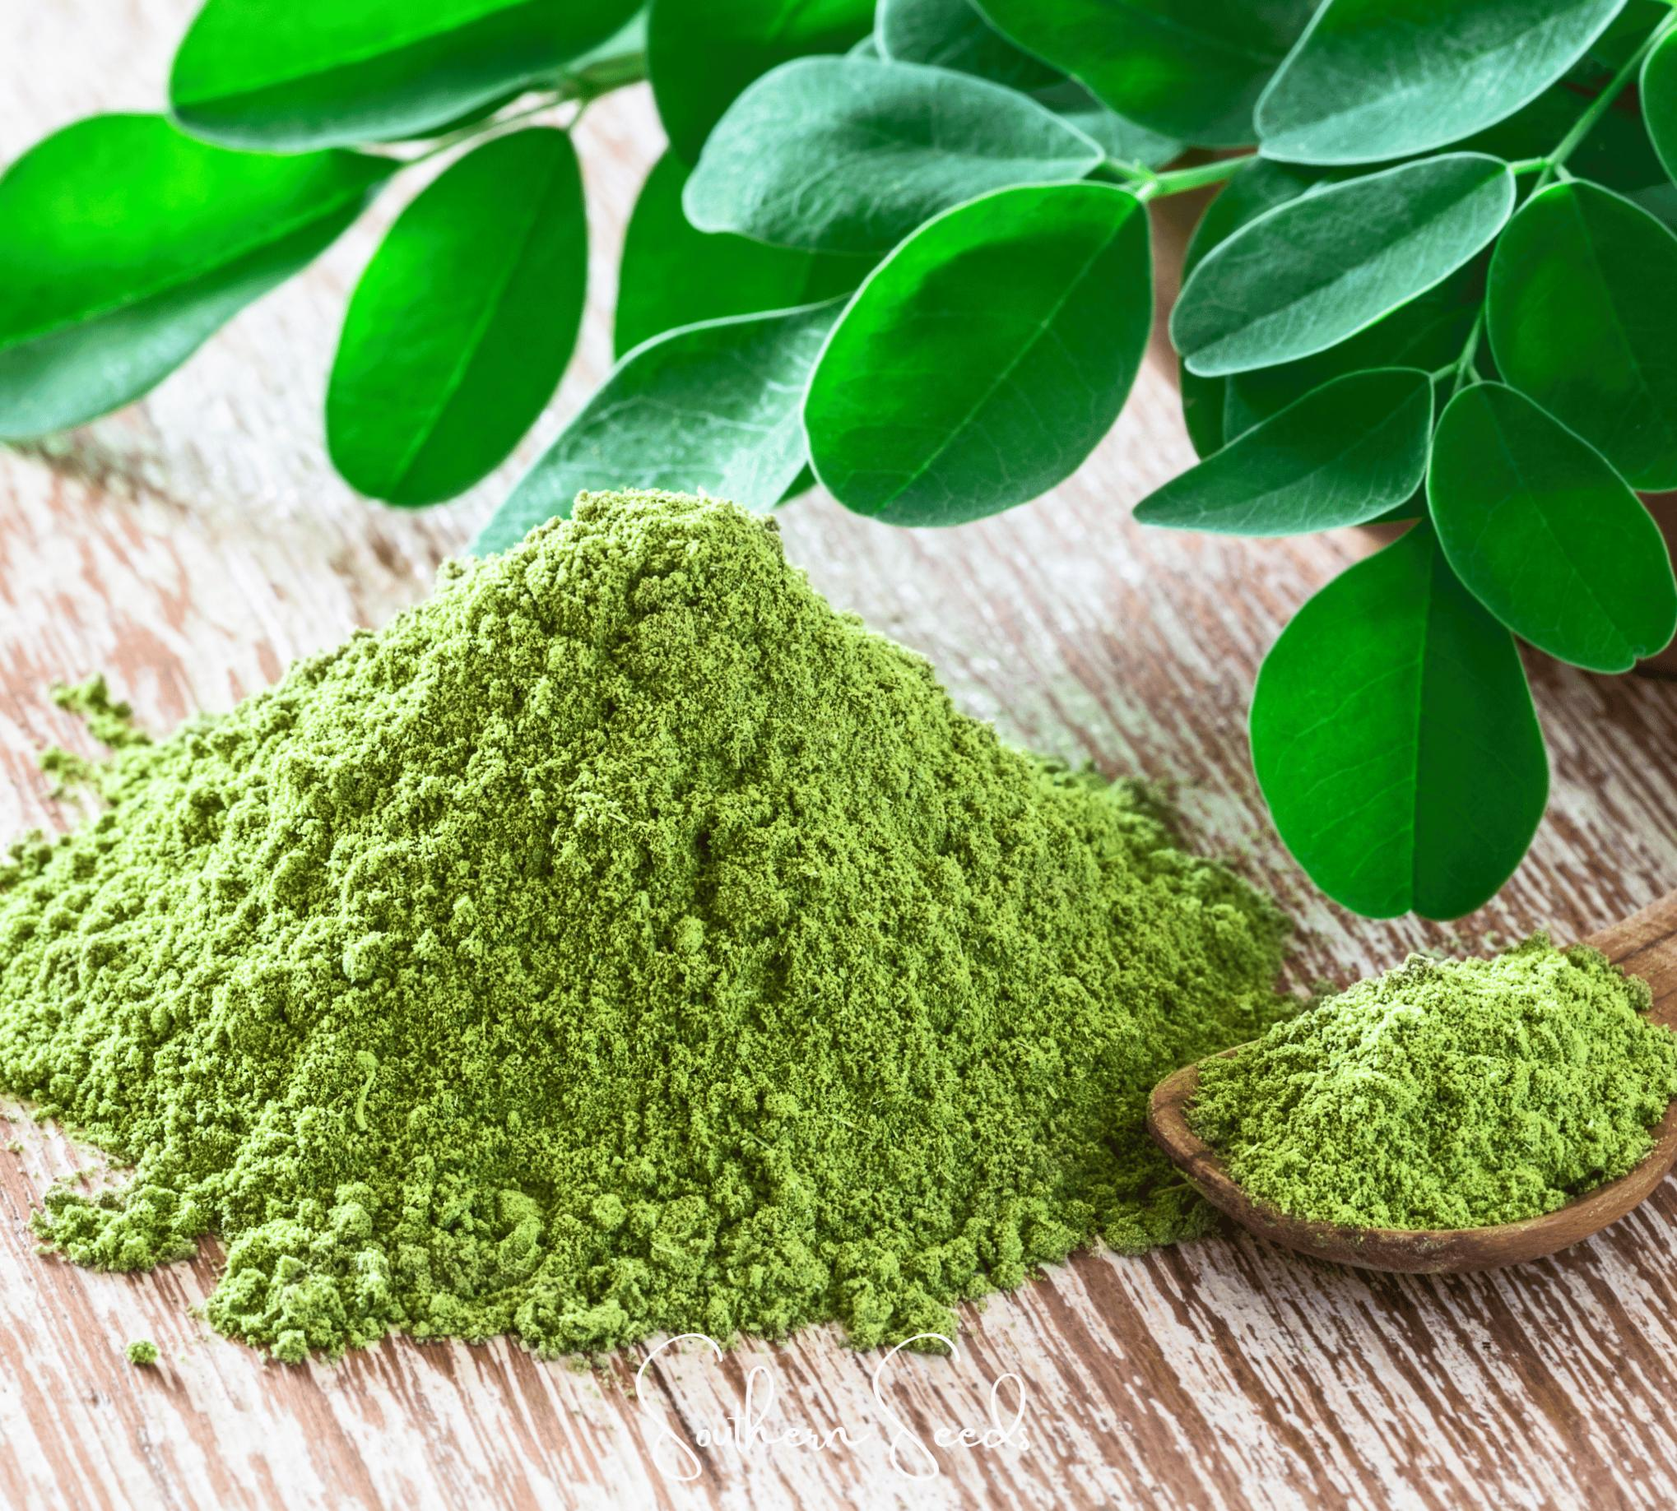
Moringa oleifera leaves value:
MO leaves contain phytosterols as β-sitosterol which can reduce intestinal uptake of dietary cholesterol that may decrease plasma cholesterol and the increase of fecal cholesterol.
The leaf extracts from MO has strong anti-proliferation and potent induction of apoptosis. So, it indicates that MO leaf extracts has potential role for cancer chemoprevention and can be used as a therapeutic target for cancer
Flavonoids act as insulin secretagogues or insulin mimetics, other studies revealed MO may be responsible for the stimulation of glucose uptake in peripheral tissues and regulation of the activity and expression of the enzymes involved in carbohydrate metabolism

Slide 8
MO leaves is useful as a natural product against hypertension. The antihypertensive effect of MO leaves may be mediated by inhibiting vascular dysfunction and oxidative stress and promoting endothelium- dependent vasorelaxation.
MO leaves also used in diarrhea, the action might be via anti- secretory action. Alcoholic extract of MO contains pharmacologically active phyto molecules with potential anti-diarrheal properties and can be used as non-specific anti-diarrheal agent.
The leaves of MO are rich in minerals (such as iron and calcium), vitamins (such as Vit. A, B and C), and proteins (as methionine, cysteine, and essential sulfur amino acid).
The leaf extract has anti-inflammatory, antihypertensive, hypolipidemic, hepatoprotective and antimicrobial activities

Slide 9
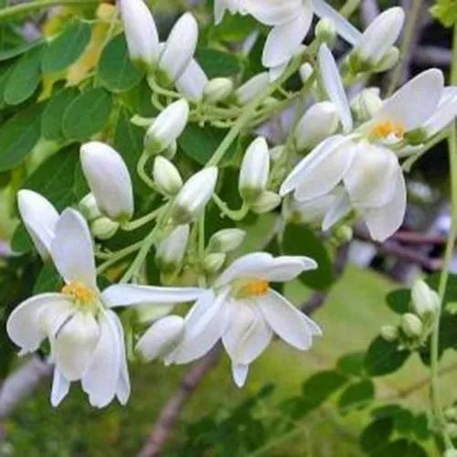
Moringa flowers value:
Flower juice improves the quality and flow of milk in lactating mothers.
Moringa Flower contains pterogospermin, an antibiotic that is highly effective in the treatment of cholera.
The flowers have the ability to cure muscle diseases, inflammations and also decrease cholesterol phospholipid and triglyceride

Slide 10
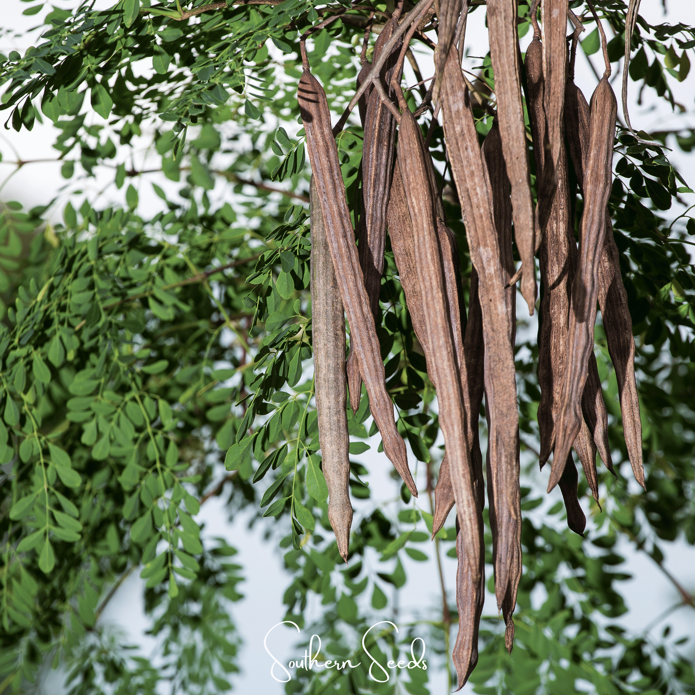
Moringa fruits value:
The fruits are rich in minerals, protein, thiamine, riboflavin, vitamin A and C.
MO fruits have antihypertensive property which is due to the presence of thiocarbamate and isothiocyanate glycoside present in it.
MO fruits have the ability to reduce the serum cholesterol, phospholipid, triglycerides, low density lipoprotein (LDL), very low density lipoprotein (VLDL),and cholesterol- phospholipid ratio. The fruits also has the ability to increase the fecal cholesterol

Slide 11
Medical uses of Moringa Olifera:
1. Antiviral action:
It showed significant activities against viruses like human immunodeficiency virus (HIV), Herpes simplex viruses (HSV), hepatitis B virus (HBV) and Epstein-Barr virus (EBV).
It is suggested that enhanced nutrition that which can be achieved via Moringa due to its high nutritional value could benefit a person with
Acquired immunodeficiency syndrome (AIDS), as its high content of vitamins and minerals enhance immunity.
2. Anti-bacterial action:
It has anti-bacterial action on the pathogenic Gram-negative and Gram-positive bacteria, affecting membrane permeability and integrity.
Ethyl acetate and acetone extracts showed maximum antibacterial activity against Escherichia coli, Staphylococcus aureus, Salmonella gallinarum and Pseudomonas aeruginosa.
These antimicrobial actions are due to activities of bioactive compounds depending on interactions between their lipid components with the net surface charge of microbial membranes

Slide 12
3. Anti-fungal action:
Essential oil of M. oleifera showed different degrees of antifungal activity.
4. Anticancer Activity:
All parts of the M. oleifera tree have been tested for anticancer activity were highly cytotoxic to cancerous cells but not to normal cells.
MO leaves inhibit cancer cell growth as It targeted the cell cycle resulting in cell sustained at sub-G1 phase. Also, MO leaves down- regulated the nuclear factor kappa B (NFκB pathway), Glucosinolates present in MO is effective against cancer and induce apoptosis.
5. Cardioprotective Activity:
Moringa also has cardio protective effect. The leaves extract have cardio protective effect which may be due to its antioxidant antiperoxidative and myocardial preservative effect

Slide 13
Central Nervous System(CNS) Activity:
MO is known to act on the CNS and cause an anti-convulsant action. Such activity is due to its action on a central mechanism, which is releasing of γ-amino butyric acid (GABA). Therefore, it has been used traditionally for the treatment of epilepsy.
MO has protective effects against degenerative and chronic neuronal diseases like Alzheimer’s disease. It has enhanced effects on memory as it works on the neurons in the hippocampus . It also has an induction effect on differentiation of myeloid cells and photoreceptors and promotes the development of neurons in the hippocampus.
MO extract potentiate morphine and pethidine-induced analgesia, The methanolic extract of the root prolong sleeping time. Also the seeds of MO have also been reported to have antipyretic effect
MO has antidepressant activity alone and also when combined administration with low doses of fluoxetine or other SSRI drugs seems to have good synergic effect.

Slide 14
7. Antiinflammatory, Antiasthmatic, Antiarthritic Activities:
The protective effect of MO extracts against protein denaturation is similar to the effect of NSAIDs which exert significant anti-inflammatory effect in arthritis. Anti-arthritic activity of MO may be due to the scavenging of free radicals, inhibition of protein denaturation, membrane stabilization and anti-trypsin activity
8. Anti-hyperlipidemia, Anti hypercholesterolemic Activities:
MO extract shows significant anticholesteremic and antilipidemic action.
MO extract inhibited lipid synthesis by down regulating HMG- CoAR, PPARα1, and PPARγ gene expression, which reduced lipid metabolism
9. Moringa and obesity:
Moringa tea helps to get loss of the body weight in a healthy way.
10. Wound Healing Activity:
MO leaves was effective in promoting and accelerating wound healing process in normal human dermal fibroblast (HDF-N) by increasing its proliferation and migration.

Slide 15
various safety studies in animals involving aqueous leaf extracts indicate a high degree of safety and
No adverse effects were reported in association with human studies.

Slide 16


