Slide 1
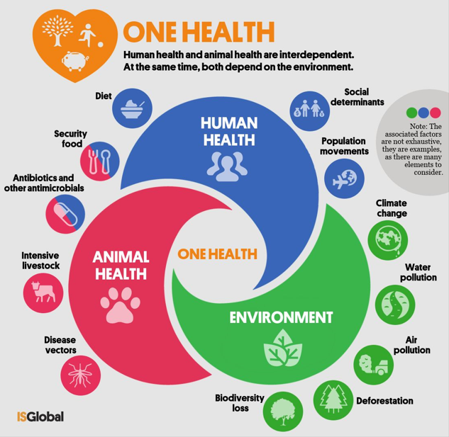
One Health Approach
Designed By : Mariam Ezzat
Demonstrator of Community Environmental and Occupational Medicine Department

Slide 2
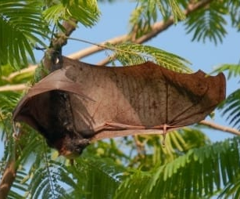

What does your health have to do with a bat in a forest?
in fact, our health is deeply intertwined with the health of animals, plants, and our shared environment .
Welcome to our discussion on: The One Health Approach.

Slide 3
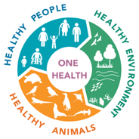
One Health approach
is a collaborative, integrated strategy recognizing that human, animal, and environmental health are interconnected, aiming to sustainably balance and optimize all three for better public health outcomes and to prevent global threats like pandemics and antibiotic resistance.
It requires cross-sectoral work between health, agriculture, and environmental sectors.

Slide 4

Core Domains of One Health
Human Health
Epidemiology
Public health systems
Disease surveillance
2. Animal Health
Veterinary public health Livestock production systems Wildlife disease ecology
3. Environmental Health
Ecosystem services
Climate change
Biodiversity and habitat disruption

Slide 5

The Environment as a Determinant of Health
While often the least emphasized pillar, environmental health is the foundational system that sustains both human and animal health. Without a healthy environment, the other two pillars cannot stand.

Slide 6

The Environment as a Determinant of Health
A. Direct Pathways of Impact
Air Quality
2. Water Quality and Security
3. Soil Quality
B. Indirect and Systemic Pathways
Climate Change as a "Threat Multiplier“
Altering Disease Patterns
Extreme Weather Events
2. Biodiversity Loss and Ecosystem Degradation
3. Food Systems and Land Use

Slide 7
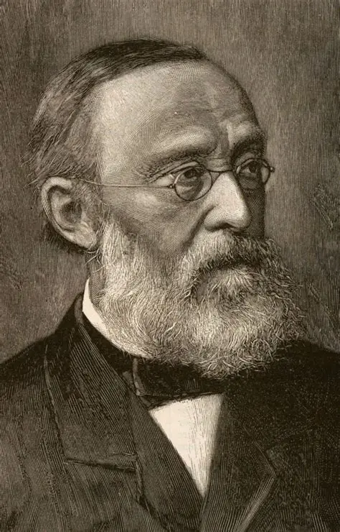

Slide 8

Historical Background
Originated from the concept of “One Medicine” (Rudolf Virchow)
Gained global recognition after:
SARS (2003)
Avian Influenza
Ebola outbreaks
Strengthened after COVID-19 as a global preventive framework

Slide 9

Why is One Health Critical Now?
Emerging Infectious Diseases: 70% of emerging human diseases (like COVID-19, Ebola, Avian Flu) originate from animals (zoonotic diseases).
Antimicrobial Resistance (AMR):
Overuse of antibiotics in humans, animals, and agriculture fuels superbugs, making infections harder to treat.
Climate Change Environmental Degradation : alters disease patterns, threatens food security, and disrupts ecosystems.

Slide 10
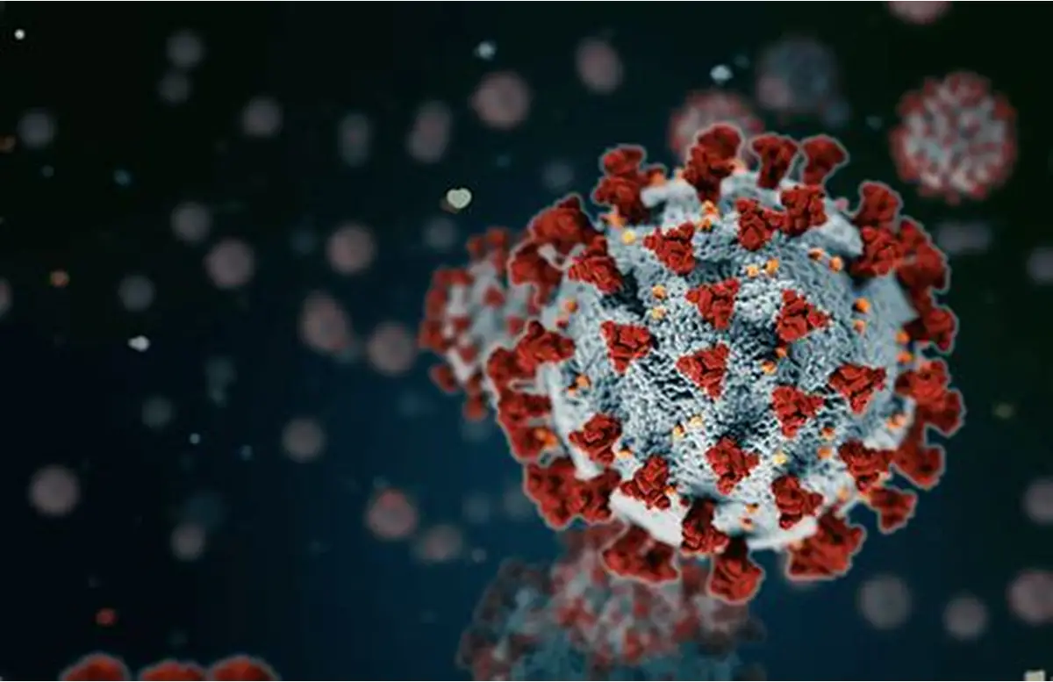
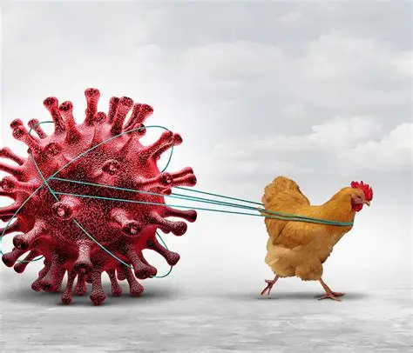
Real-World Examples
COVID-19 Pandemic:
A stark example of a zoonotic virus requiring global collaboration between virologists, epidemiologists, veterinarians (to trace origins), and public health experts.
Avian Influenza (Bird Flu)
Action: Vets monitor poultry farms, doctors report human cases, environmentalists track wild birds.
Result: Early warning prevents widespread outbreaks in humans and protects food supply.

Slide 11
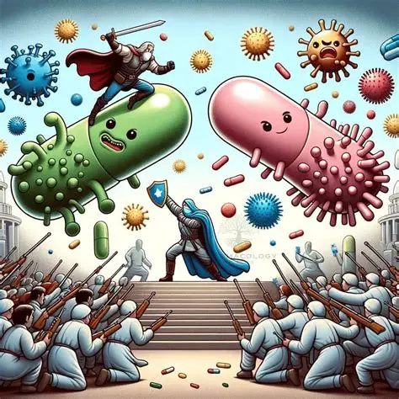
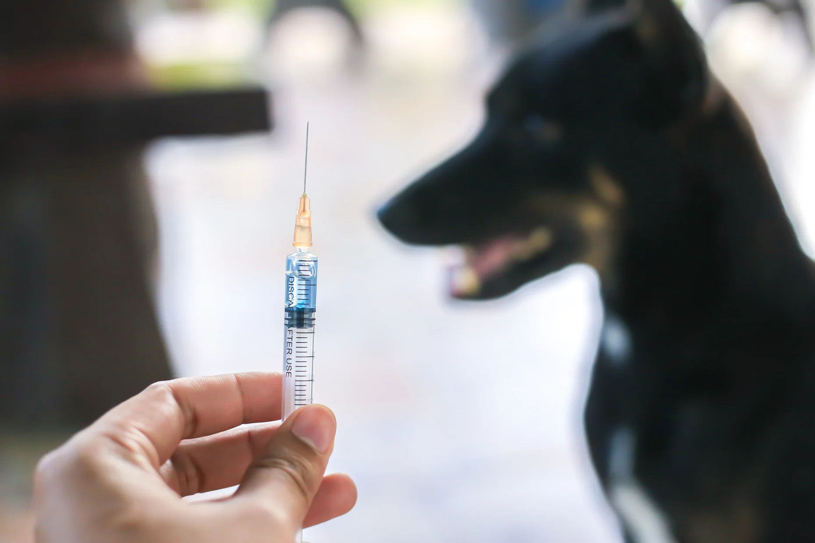
Fighting Antibiotic Resistance:
Action: Hospitals track human use, farms reduce antibiotics in livestock, scientists monitor resistance in water.
Result: Slows creation of "superbugs," keeping antibiotics effective for all.
Rabies Elimination Campaigns:
Action: Vets vaccinate dogs, doctors treat exposed people, communities are educated.
Result: Protects human lives and controls disease in animal populations.

Slide 12
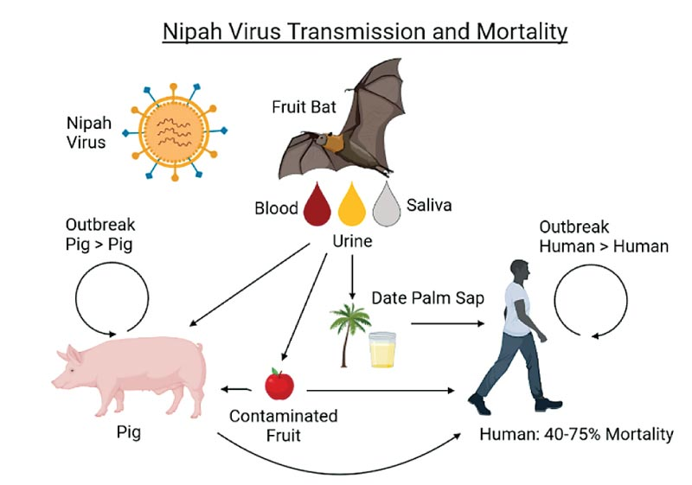
The Nipah Virus Outbreak
Trigger: Deforestation in Southeast Asia for pig farming and fruit plantations.
Environmental Disruption: Loss of natural habitat for fruit bats (the natural host).
Spillover: Bats forage in orchards near pig farms. Bat saliva/urine contaminates fruit
or pig feed. Pigs become intermediate hosts, then transmit the virus to humans.
Conclusion: Land-use change (environmental factor) was the critical driver of this zoonotic emergence.

Slide 13
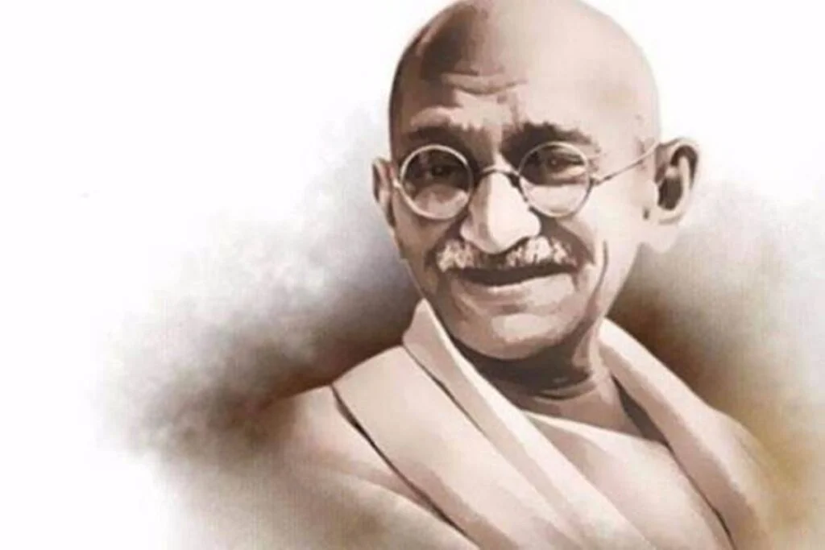
"The earth, air, land, and water are not an inheritance from our forefathers but on loan from our children. So we have to handover to them at least as it was handed over to us."
Adapted from
Mahatma Gandhi.

Slide 14

How Can We Apply the One Health Approach?
Applying One Health starts with changing our mindset from separation to connection, then building systems that reflect this truth.
At the Individual & Community Level:
Use antibiotics only when prescribed.
Vaccinate your pets.
Choose sustainable food products.
Report sick or dead animals to authorities.
2. At the Professional & Institutional Level:
Break the Silos: Create joint teams (doctors + vets + ecologists) for research and outbreak response.
Share Data & Resources: Connect human hospitals, veterinary labs, and environmental monitoring stations.
Integrated Education: Teach together in shared courses.

Slide 15
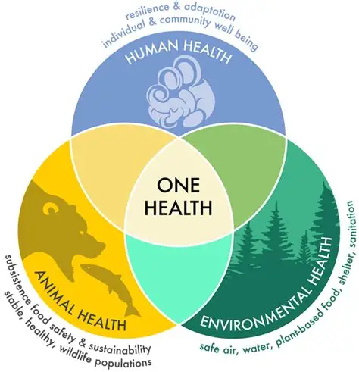
3. At the National & Policy Level:
Form National One Health Committees: Include ministers of health, agriculture, environment, and academia
Develop Joint Surveillance Systems: One early-warning network for human, animal, and environmental threats. Pass Supportive Laws: Regulations that link antibiotic use in farming to public health, and protect ecosystems as a health measure.
4. At the Global Level:
Strengthen the Quadripartite: Support WHO, FAO, WOAH, and UNEP in their joint One Health plans.
Fund Joint Research: Invest in international projects studying disease origins at the human-animal-environment interface.

Slide 16
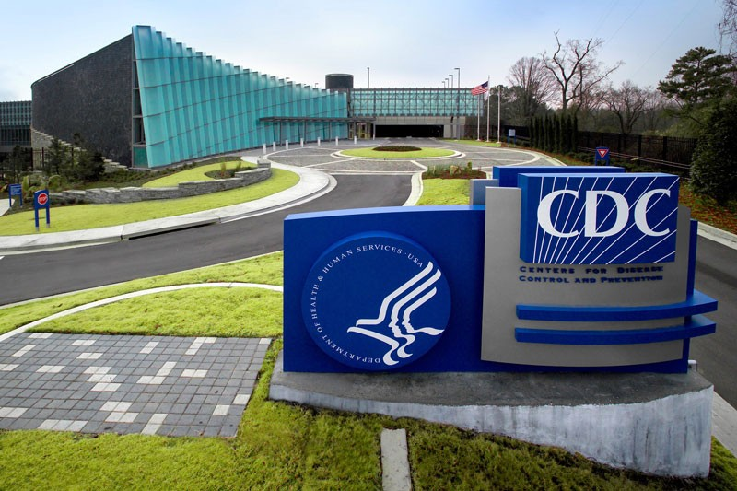
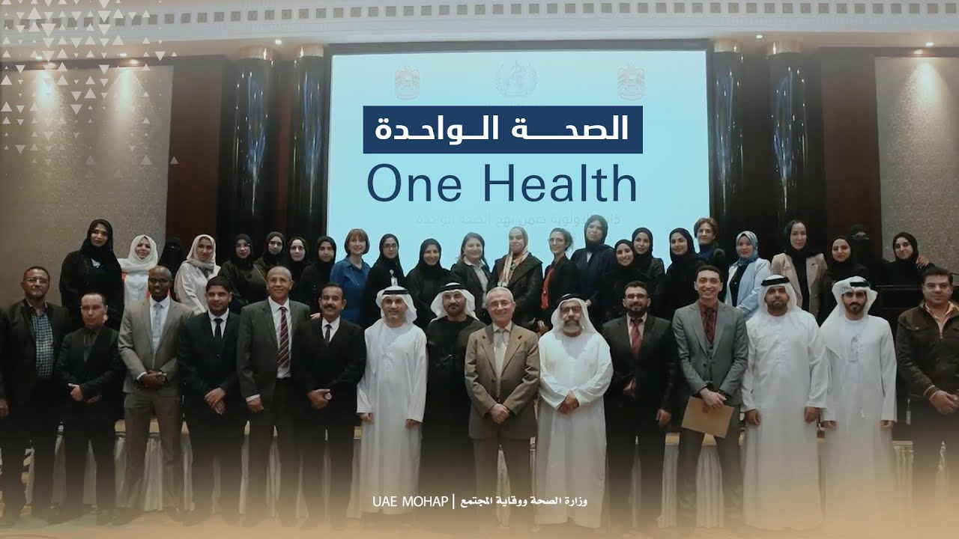
One Health Initiatives
international application
United States Initiative The "One Health Office"
Location: Centers for Disease Control and Prevention (CDC).
National Role: The central coordinating body for One Health efforts across the country.
Regional application
Saudi Arabia Initiative
"One Health" within Vision 2030·
Location: A national strategic priority embedded in the country's overarching development plan. National Role: A framework for national health security and economic diversification.

Slide 17

National application
The "One Health" Pillar within "Decent Life" (Haya Karima)·
Framework: Part of the presidential mega-project for rural development.
Integration: One Health components are embedded in village development.
Human Health: Vaccination campaigns & primary healthcare services.
Animal Health: Livestock vaccination and veterinary care.
Environmental Health: Clean water, sanitation, and waste management projects.

Slide 18
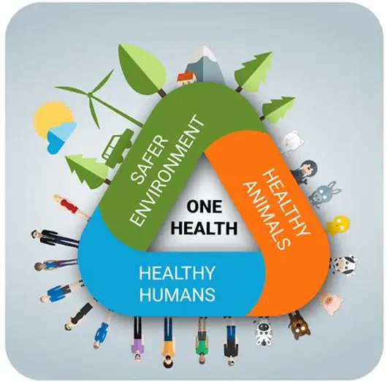
Conclusion
One Health is not just a concept; it's a necessary strategy for a safer, healthier world.
By breaking down barriers between disciplines, we can build a more resilient global health system.

Slide 19
REFERNCES
World Health Organization (WHO), et al. One Health Joint Plan of Action (2022-2026). Geneva: WHO.
The World Bank. People, Pathogens and Our Planet, Volume The Economics of One Health. 2012.
FAO, OIE, WHO. The Tripartite’s Commitment: Providing multi-sectoral, collaborative leadership in addressing health challenges. 2017
One Health Commission: www.onehealthcommission.org
CDC One Health Office: www.cdc.gov/onehealth
WOAH (OIE) One Health: www.woah.org/en/what-we-do/global-initiatives/one-health
WHO One Health: www.who.int/health-topics/one-health

Slide 20


